Slide 1
FRONT-YARD DESIGN NOTES
Native Pollinator Garden
A clean, layered native bed that feeds pollinators March through frost. Notes drafted January 2027 for spring planting.

Slide 2
The goal
• Feed pollinators across the whole season and look intentional from the street.
• Share air with the greenhouse, so no pesticides; I react to chemicals anyway.
• A mulch path so Emma can get in to photograph bees for school.

Slide 3
Plant palette, Ohio natives
• Purple coneflower (Echinacea purpurea)
• Black-eyed Susan (Rudbeckia)
• Bee balm (Monarda), give it air for mildew
• Butterfly milkweed (Asclepias tuberosa), for monarchs
• Coreopsis, for the long yellow bloom
• Little bluestem grass, structure and winter interest

Slide 4
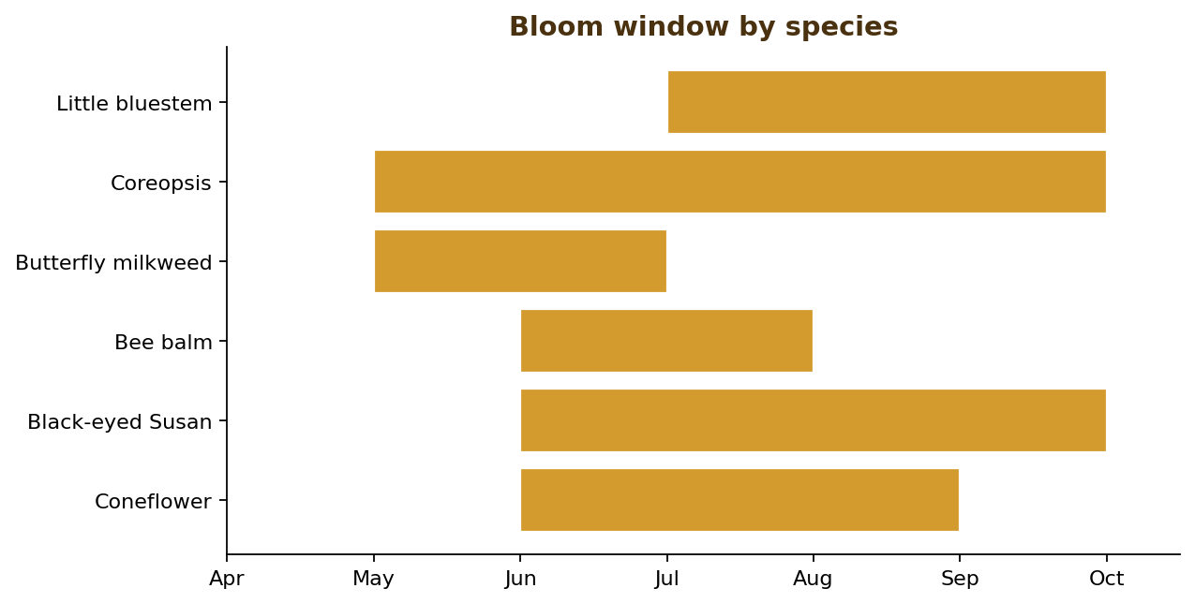
Bloom calendar
• Layered so something is always in flower.
• Stems left standing over winter for overwintering insects.
• Coreopsis and Rudbeckia carry the late season.
Bloom window by species, April to October

Slide 5
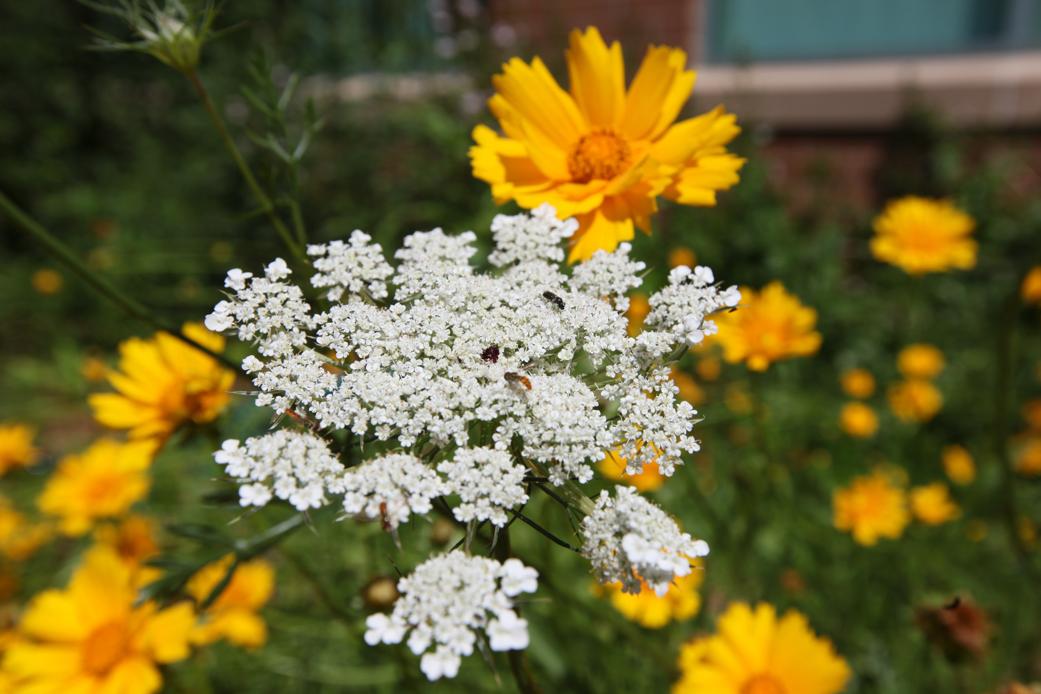
The look I am after
Layered natives with steady pollinator traffic, here Queen Anne's lace and coreopsis

Slide 6
Layout
• Taller at the back (Joe-Pye toward the fence), low edgers at the walk.
• Mulch path through the middle for access and photos.
• Compost topped up; soaker hose checked each spring.

Slide 7
Tasks
• Order plugs in late winter, after the holidays and before the spring rush.
• Cut back last year's stems once temps are reliably warm.
• Top up compost; check the soaker hose.

Slide 8
The point
• Quiet, slow, native.
• Anything worth having takes time and care.

